Slide 1

Solar Power Plant design

Slide 2
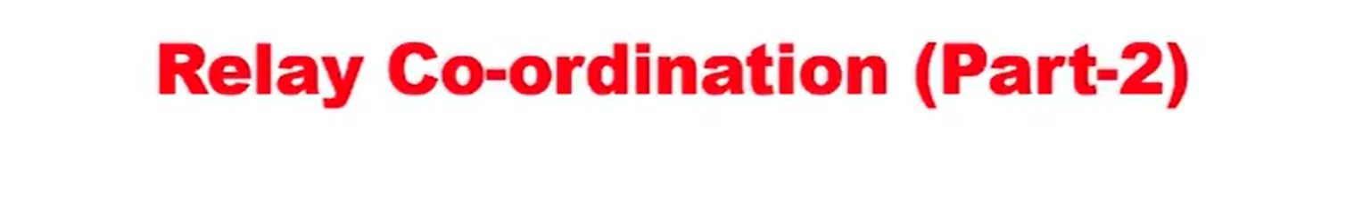

Slide 3
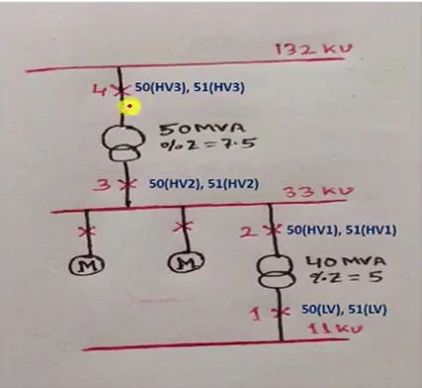
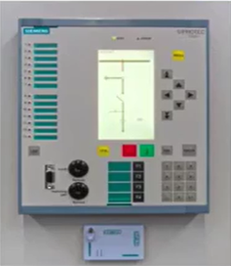
Phase O/C Function in Relay

Slide 4
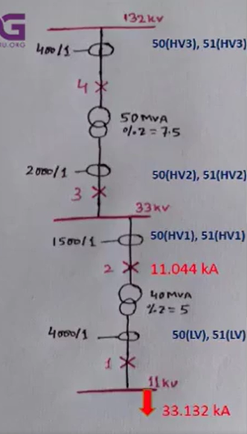
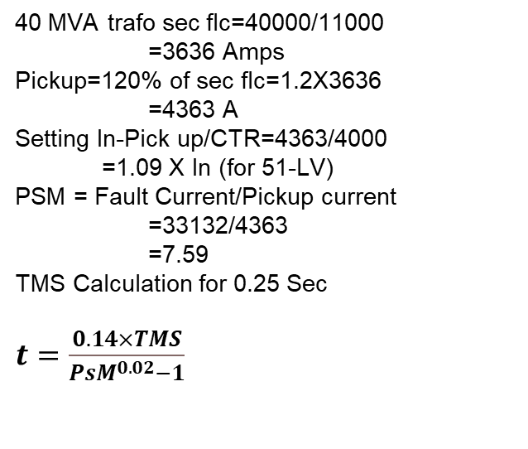


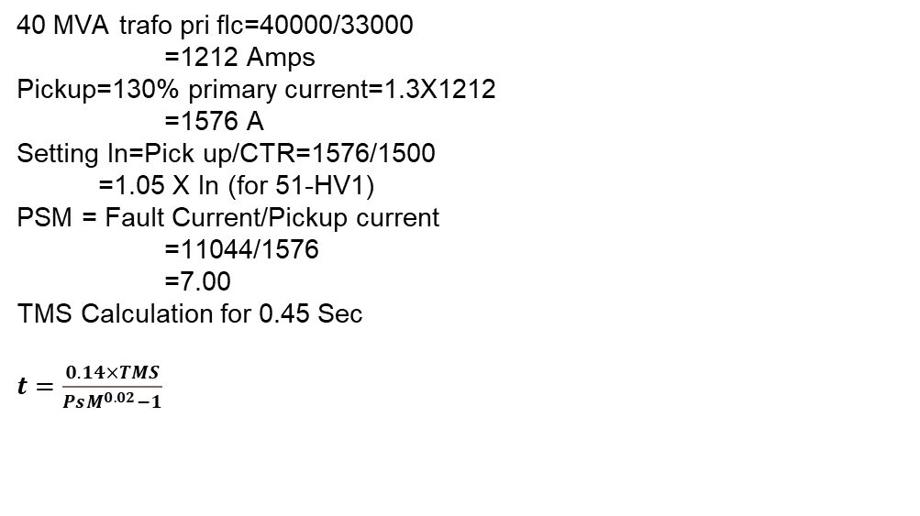
40 MVA trafo sec flc=40000/11000
=3636 Amps
Pickup=120% of sec flc=1.2X3636
=4363 A
Setting In-Pick up/CTR=4363/4000
=1.09 X In (for 51-LV)
PSM = Fault Current/Pickup current
=33132/4363
=7.59
TMS Calculation for 0.25 Sec
$t=\frac{0.14×TMS}{PsM^{0.02}−1}$
40 MVA trafo pri flc=40000/33000
=1212 Amps
Pickup=130% primary current=1.3X1212
=1576 A
Setting In=Pick up/CTR=1576/1500
=1.05 X In (for 51-HV1)
PSM = Fault Current/Pickup current
=11044/1576
=7.00
TMS Calculation for 0.45 Sec
$t=\frac{0.14×TMS}{PsM^{0.02}−1}$
$0.25=\frac{0⋅14xTMS}{7⋅{59}^{0.02}−1}$ = 0.074 (For 51 – LV)
$0.45=\frac{0⋅14xTMS}{7⋅{59}^{0.02}−1}$ = 0.13 (For 51 – HLV)

Slide 5
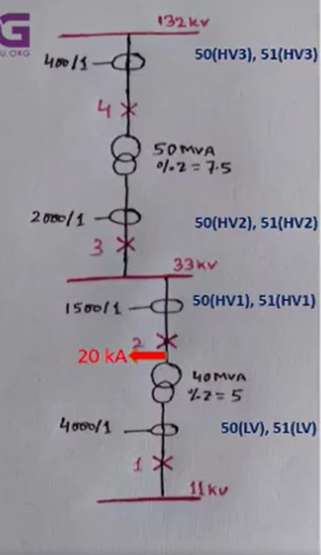
Fault at 33 kV Transformer side =20 kA
Pickup for 50(LV) = 400% of 40 MVA Trafo sec FLC
= 4 X 3636 = 14544 A
Current Setting for 50(LV) = Pickup Current/CTR
= 14544/4000 = 3.64 X In
Delay =0.10 Sec
40 MVA Trafo inrush current = 6 X Ip
=6*1212
=7272 A
Pickup for 50(HVI) = 120% of Trafo Inrush
= 1.2X 7272=8726 A
Current Setting for 50(HV1)=Pickup Current/CTR
=8726/1500 =5.8 X In
Delay = 0.30 Sec

Slide 6
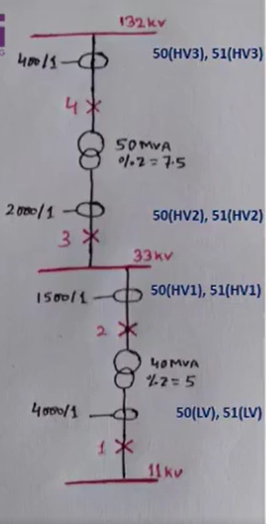
Phase O/C Function in relay
LV RELAY SETTING HVI RELAY SETTING
51 Protection =Enabled
51-1 Char =SI
51-1 Setting =1.09 x In
51-1 TMS =0.074
50 Protection =Enabled
50-1 Setting =3.64 X In
50-1 Delay =0.10 Sec
51 Protection =Enabled
51-1 Char =SI
51-1 Setting =1.05 x In
51-1 TMS =0.13
50 Protection =Enabled
50-1 Setting =5.80 X In
50-1 Delay = 0.30 Sec

Slide 7
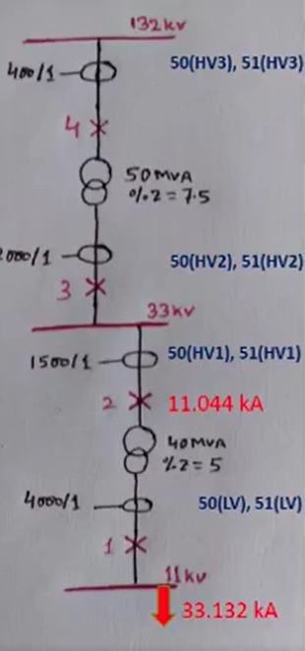

Phase O/C Function in relay
Time discrimination of 200 mS or 0.2 sec shall be maintained.
Setting for 51 (HV2) shall be based on reflection of 11KV fault current at 33 KV Side
Setting of 50(HV2) Should be less than fault at 33 KV Side but higher than 50(HV1)
50 MVA trafo sec flc= 5oooo/33000
=1515 Amps
Pickup = 130% of sec flc = 1.3 X 1515
=1970 A
Setting In=Pick up/CTR=1970/2000
=0..99 X In (for 51-HV2)
PSM = Fault Current/Pickup current
=11044/1970
=5.60
TMS Calculation for 0.65 Sec
Pickup current of 50(HV1) was 5.8 X In, i.e.
8700A & with time delay of 0.30 Sec
Pickup=110% of 50(HV1)=1.1X8700
=9570 A
setting In=Pick up/CTR = 9570/2000
=4.79 X In (for SO-HV2)
Delay = 0.50 sec
$t=\frac{0.14×TMS}{PsM^{0.02}−1}$
$0.65=\frac{0⋅14xTMS}{5⋅6^{0.02}−1}$ = 0.16 (For 51 – HV2)

Slide 8
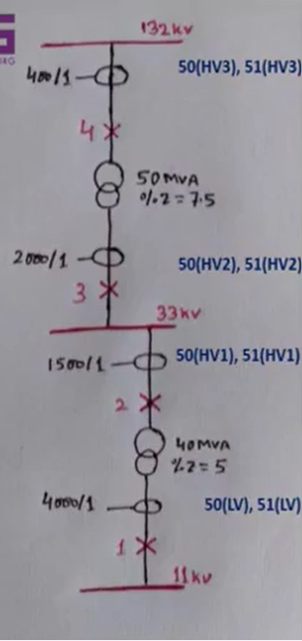
LV RELAY SETTING HVI RELAY SETTING HV2 RELAY SETTING
51 Protection =Enabled
51-1 Char =SI
51-1 Setting =1.09 x In
51-1 TMS =0.074
50 Protection =Enabled
50-1 Setting =3.64 X In
50-1 Delay =0.10 Sec
51 Protection =Enabled
51-1 Char =SI
51-1 Setting =1.05 x In
51-1 TMS =0.13
50 Protection =Enabled
50-1 Setting =5.80 X In
50-1 Delay = 0.30 Sec
51 Protection =Enabled
51-1 Char =SI
51-1 Setting =0.99 x In
51-1 TMS =0.16
50 Protection =Enabled
50-1 Setting =4.79 X In
50-1 Delay = 0.50Sec

Slide 9
Thank You

